Slide 1


AI-Powered Plant Disease Diagnosis and Treatment Recommendation System
SIMATS ENGINEERING Saveetha Institute of Medical and Technical Sciences Chennai-602105.
Presented By:
Sridharan K (192421335)
Sugin Balaji G (192321111)
Madhu Balan I (192321142)
Sudharsan S (192321077)
Kumaran M (192525022)
Guided by
Dr. R C Jeni Gracia

Slide 2

ABSTARCT
Plant diseases reduce crop yield and quality.
Manual disease detection is slow and inaccurate.
This project uses AI and Deep Learning to detect plant diseases.
The system analyses leaf images and identifies diseases.
The solution improves crop health and farming efficiency.

Slide 3
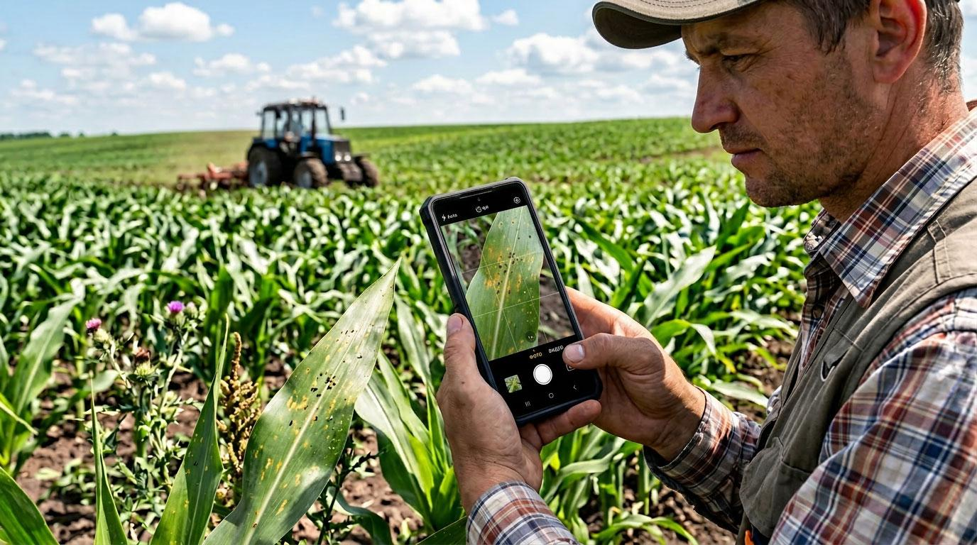
objective
Detect plant diseases automatically using AI.
Analyse leaf images using Deep Learning.
Identify the type of plant disease accurately.
Improve farming productivity and decision-making.

Slide 4
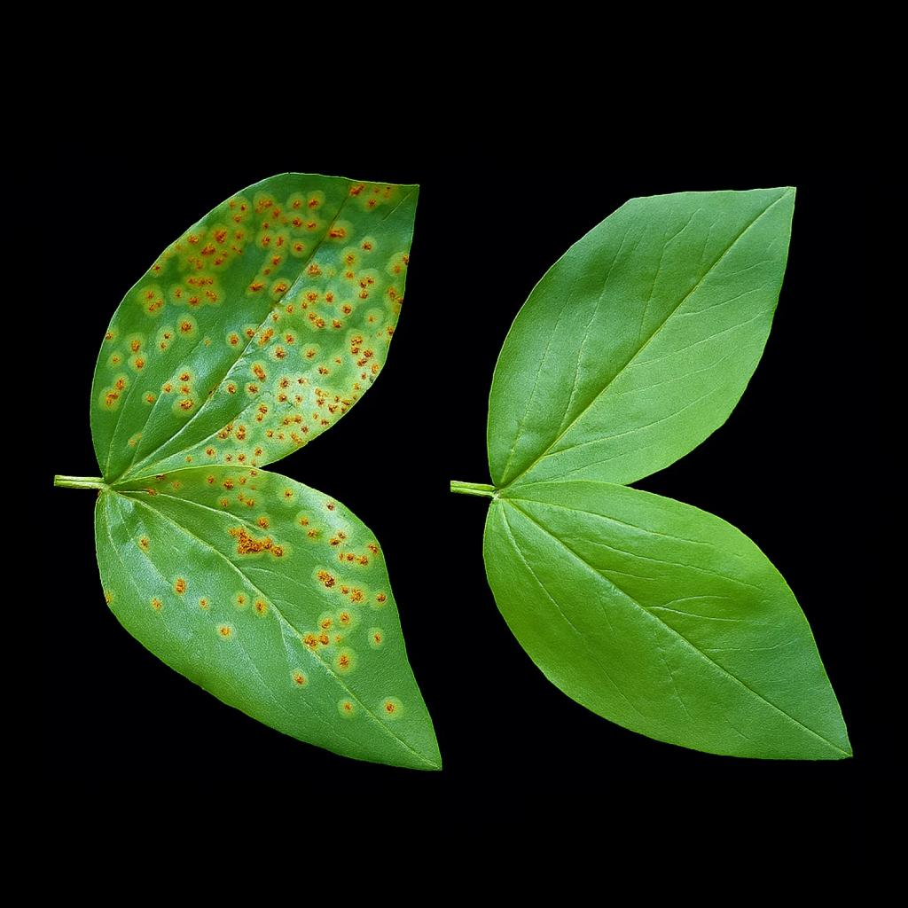
INTRODUCTION
Plant diseases cause major losses in crop yield and quality.
Farmers often rely on manual disease detection, which is slow and inaccurate.
AI and Computer Vision help analyse plant leaf images automatically.
Deep Learning identifies plant diseases with high accuracy.
It helps farmers improve crop health and agricultural productivity.

Slide 5
Problem statement
Manual plant disease detection is slow and time-consuming.
Farmers may misidentify diseases due to limited expertise.
Late disease detection can reduce crop yield and quality.
Choosing the correct treatment is often difficult.
There is a need for an AI-based system that automatically detects plant diseases and recommends suitable treatments.
📚

Slide 6
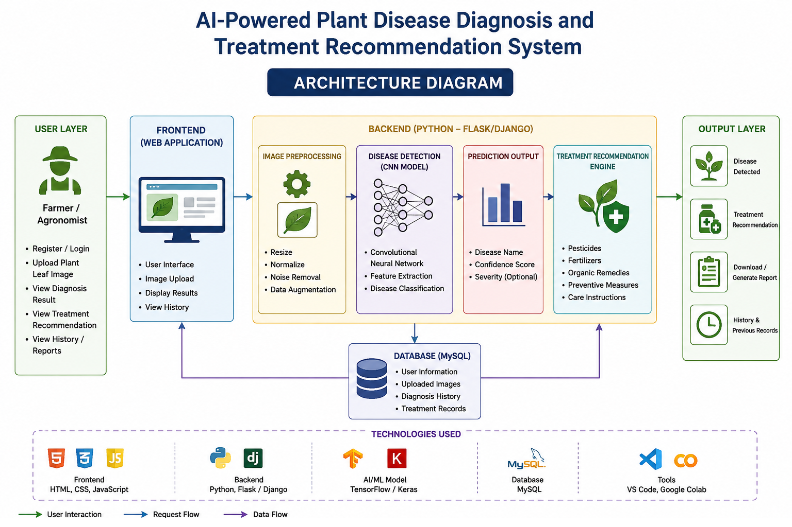
Architecture DIAGRAM

Slide 7
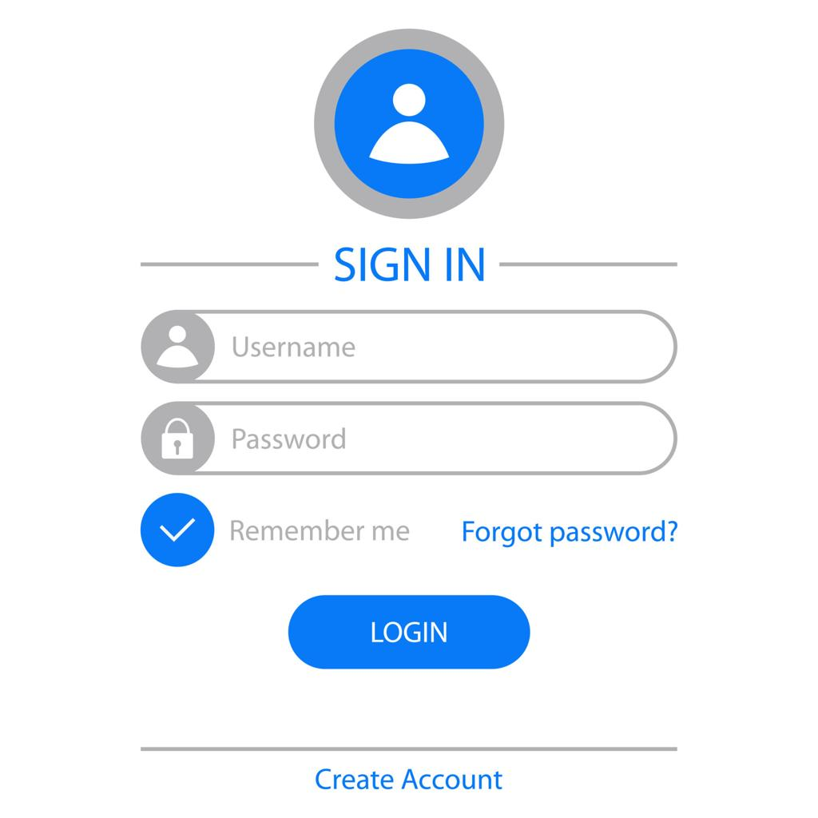
MODULE 1 : User Management
Allows users to register with their details.
Provides secure login authentication.
Stores user profile information.
Enables users to access the system securely.
Maintains user account and activity history.

Slide 8
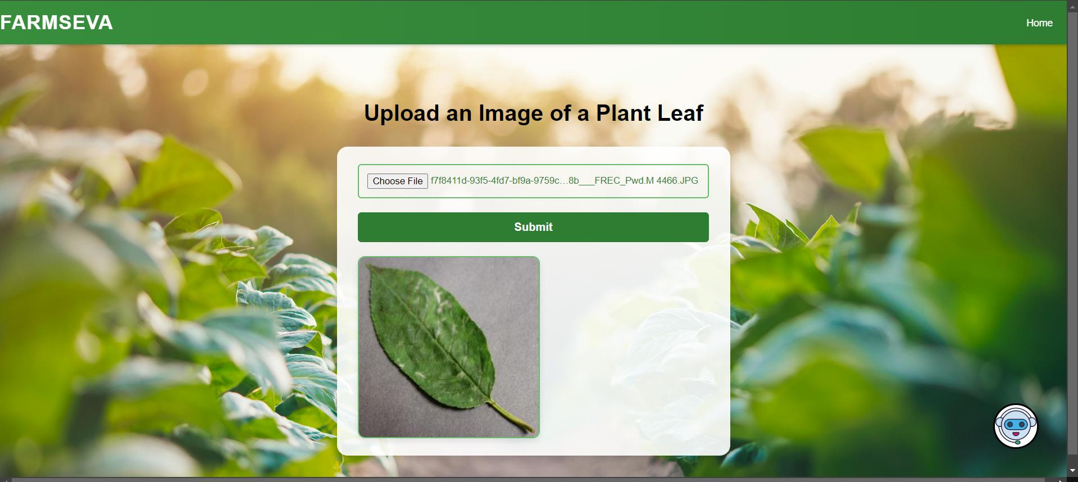
MODULE 2: Plant Image Acquisition and Preprocessing
Allows users to upload plant leaf images.
Resizes the uploaded images.
Removes noise and enhances image quality.
Prepares the image for AI analysis.
Improves the accuracy of disease detection.

Slide 9
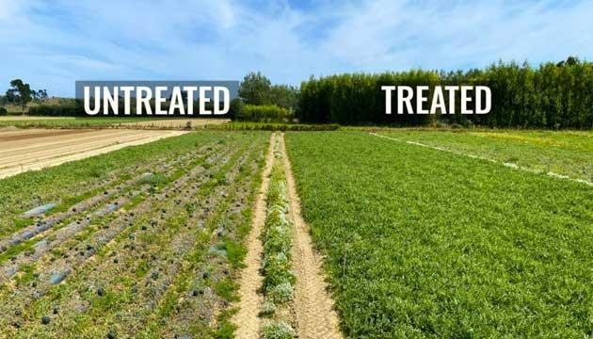
MODULE 3: Treatment Recommendation System
Recommends suitable treatments.
Suggests pesticides and fertilizers.
Provides organic remedy options.
Gives preventive measures for future protection.
Helps farmers control plant diseases effectively.

Slide 10
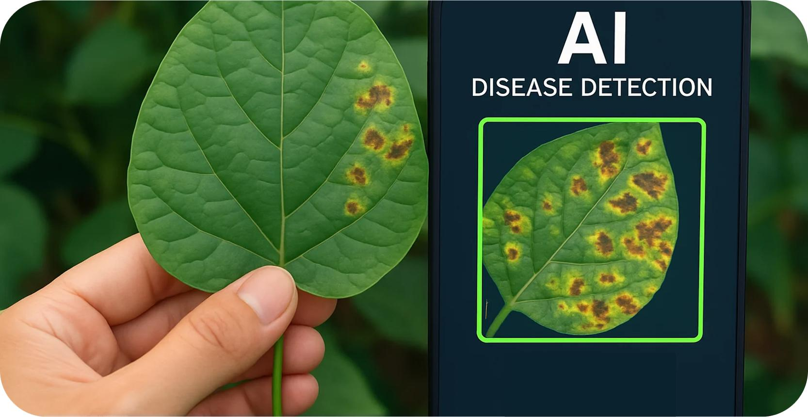
MODULE 4: AI-Based Plant Disease Detection
Analyses the uploaded leaf image.
Detects the plant disease using AI.
Identifies the disease name.
Displays the prediction confidence score.
Sends the result to the recommendation module.

Slide 11
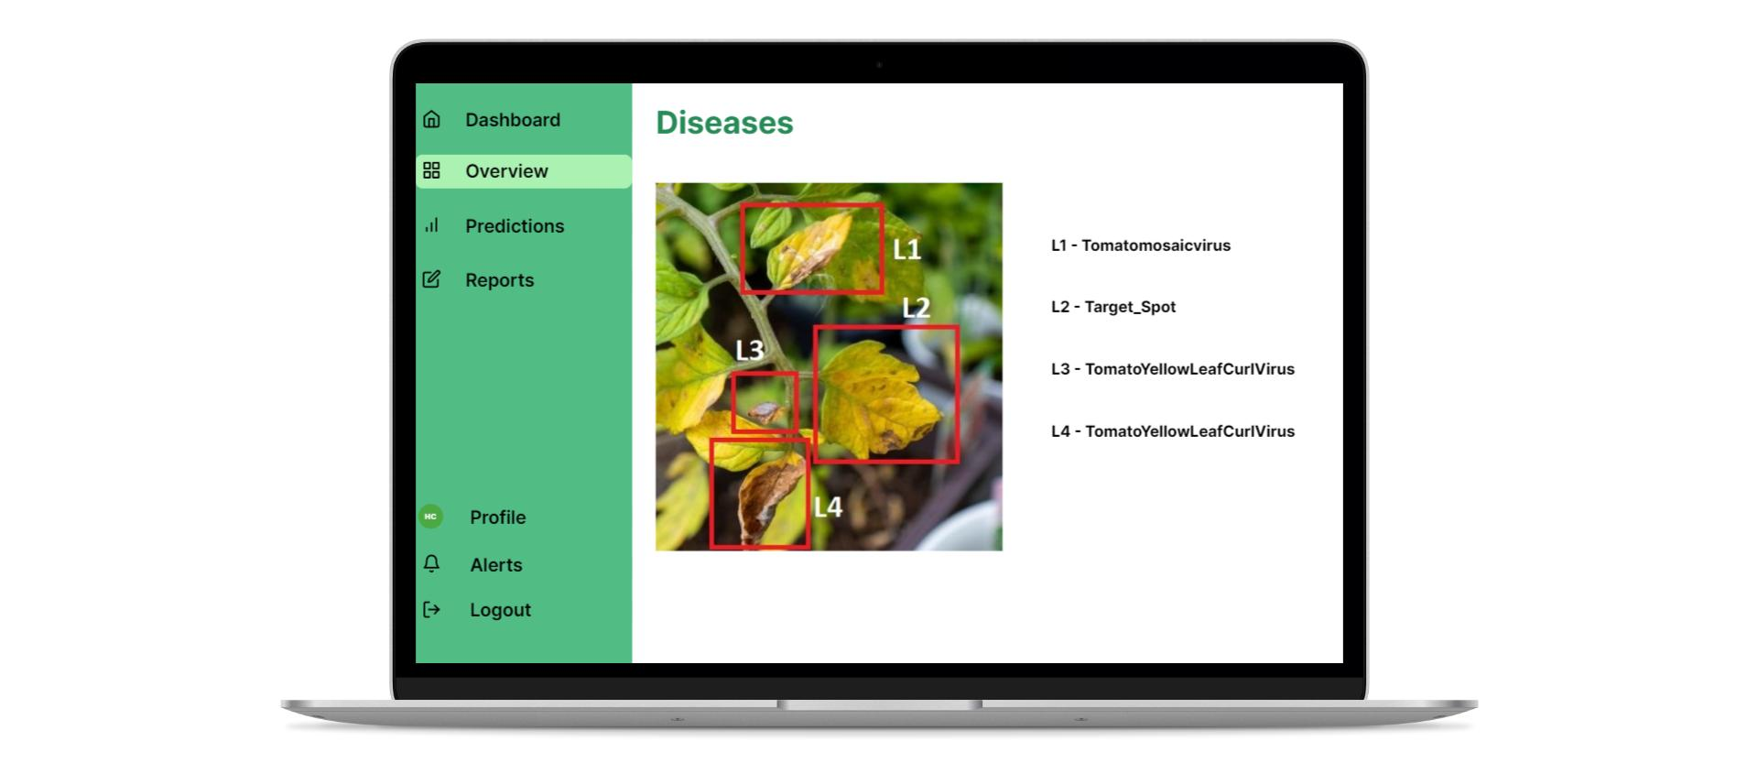
MODULE 5: Report Generation and History Management
Stores diagnosis results in the database.
Maintains users' diagnosis history.
Generates detailed diagnosis reports.
Allows users to view previous records.
Enables report download for future reference.

Slide 12
MODUE 5: Report Generation and History Management
Stores diagnosis results in the database.
Maintains users' diagnosis history.
Generates detailed diagnosis reports.
Allows users to view previous records.
Enables report download for future reference.

Slide 13
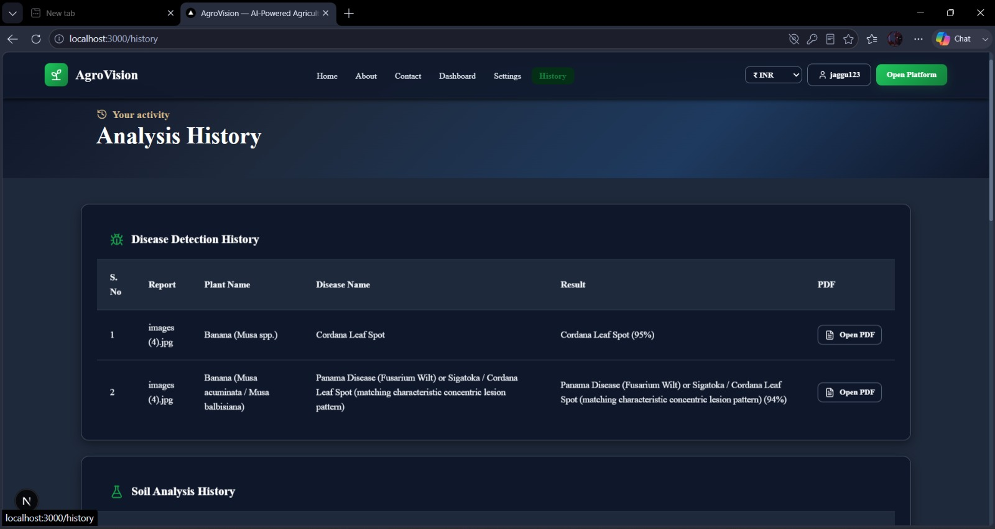
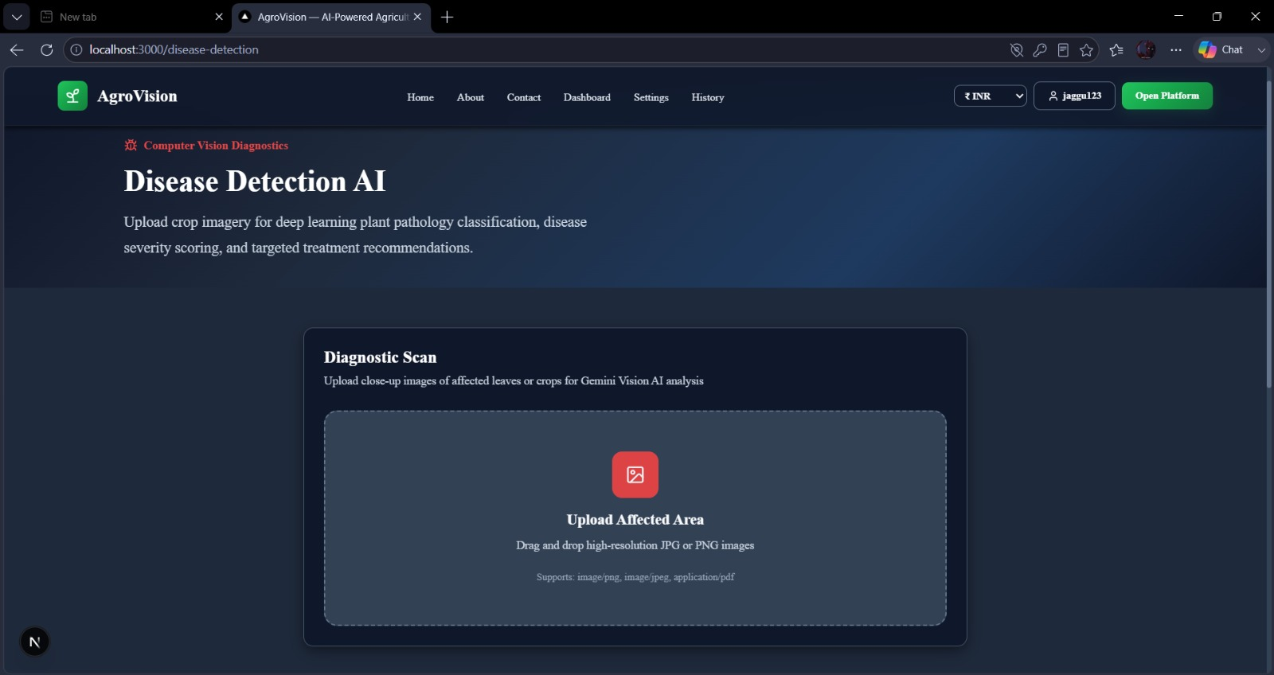
IMPLEMENTATION

Slide 14
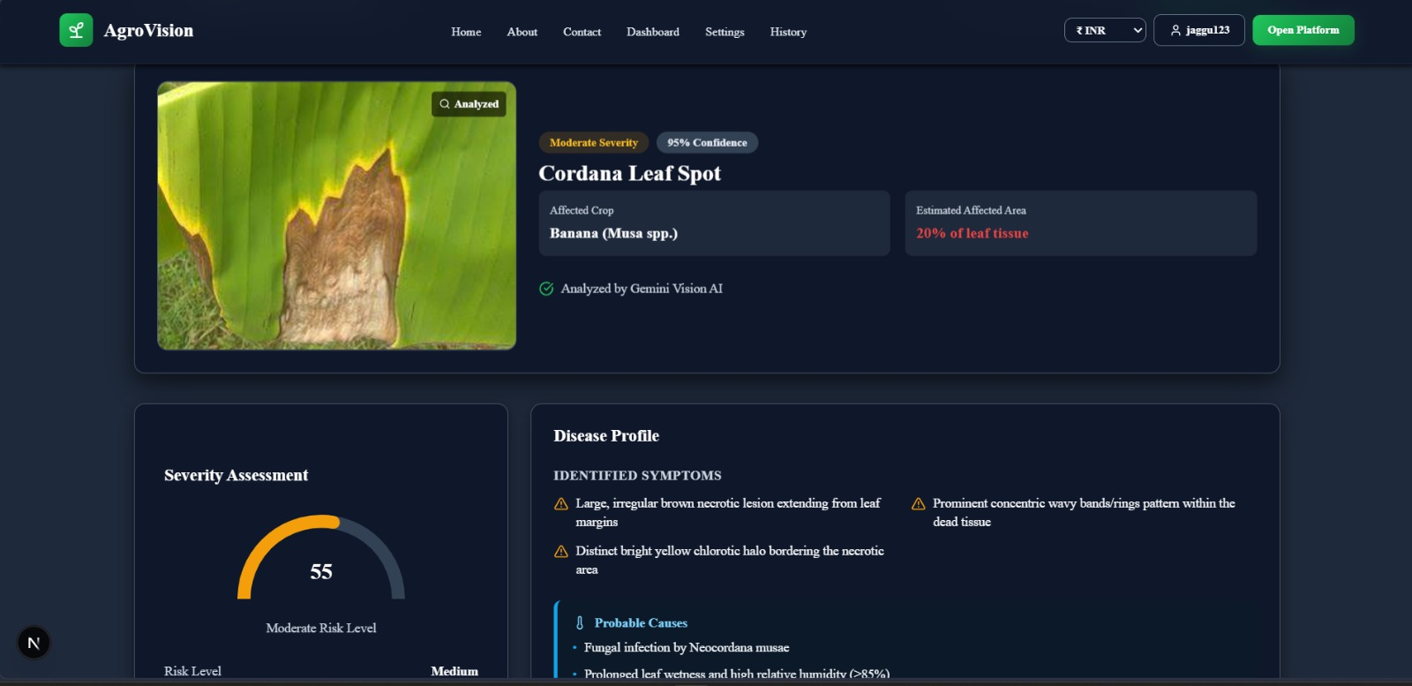
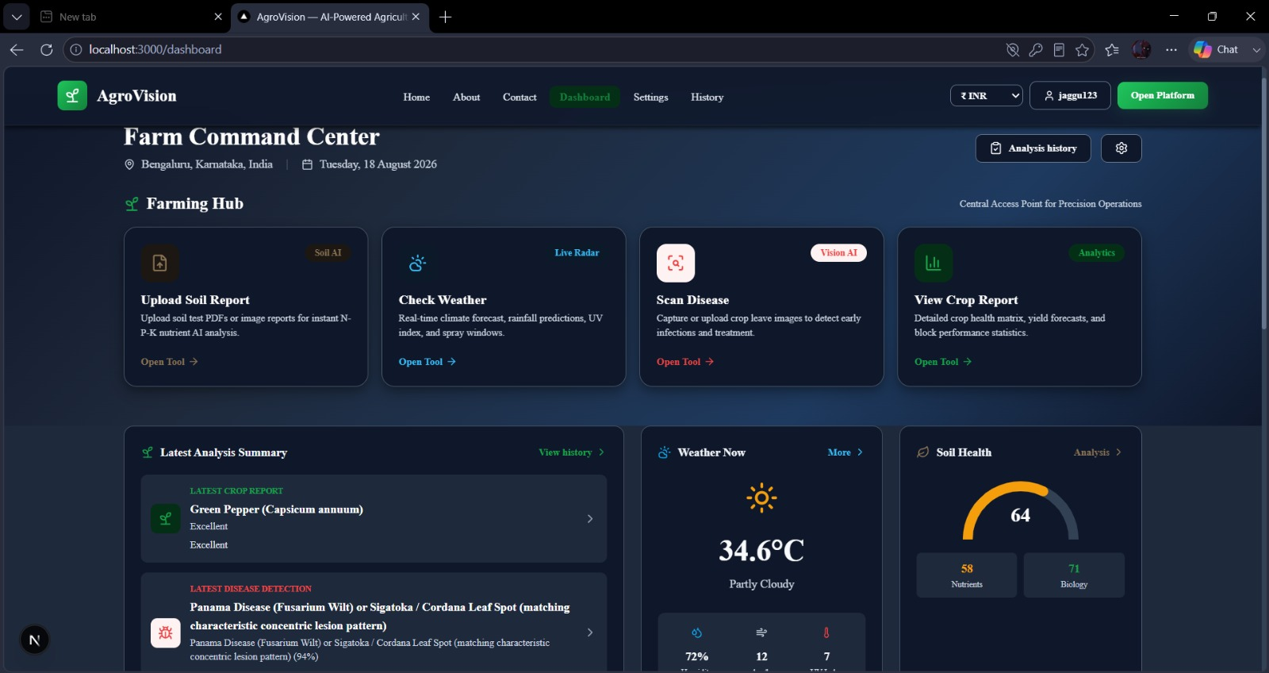
RESULT

Slide 15
Conclusion
The system detects plant diseases accurately using AI.
It provides suitable treatment recommendations.
Early detection helps reduce crop losses.
The system saves time and improves farming efficiency.
It supports smart and sustainable agriculture.

Slide 16
references
Nigam, S., & Jain, R. (2020). Plant Disease Identification Using Deep Learning.
Liu, B., Zhang, Y., He, D., & Li, Y. (2021). Plant Disease Detection Based on
Deep Learning. Agarwal, M., et al. (2023). Deep Learning-Based Plant Disease Detection: A Review.
Devarajan, D., et al. (2026). AI-Based Real-Time Disease Diagnosis in Plants Using Deep Learning Driven CNNs.
Ghimire, S., et al. (2026). AI-Driven Plant Disease Detection and Diagnosis: A Comprehensive Review.

Slide 17
THANK YOU

